Slide 1
High Hit-Rate Hiring Tactical Lessons Learned
Ilan Gur, PhD
October 20, 2016
Cyclotron Road Working Session

Slide 2
Agenda
Sourcing talent
Leveraging your network
Building a process
Staying focused
The courting process
Evaluating the candidate
Typical process
Closing the deal
After the close
Working session

Slide 3
Hiring
At early stage, team is everything. Once you have the resources, hiring is one of the biggest, hardest, and most important parts of your job as founder/executive
Building a top team is your responsibility – not just your direct reports but across the org chart
Easy to underestimate amount of effort required
If hiring lifts a bottleneck, prioritize over all else

Slide 4
Sourcing Talent
Vast majority of your hires at early stage will and should come from internal network
Create, compile, and cultivate your shared network – keep adding as you meet people you respect/like/trust
Identify, track, and constantly contact the top nodes (academic groups, industry experts, etc.)

Slide 5
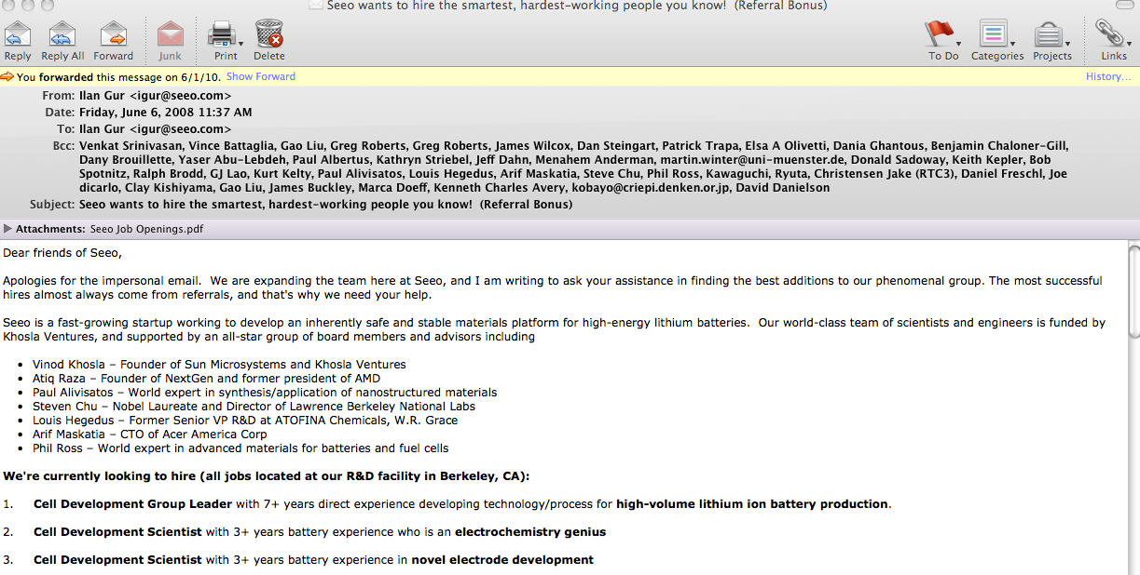
Reaching Out to Your Network

Slide 6
Reaching Out to Your Network
Keep it short/clean → move details to link or attachment
Highlight info that will entice the people you are targeting
Ask for redistribution
Referral bonuses are cheap and can increase good will among your network

Slide 7
Facilitating/Tracking the Process
Each lead represents an enormous amount of time and energy
When possible, create communication templates & have someone else be you for initial interactions
Develop a process or use an app to facilitate, track, and stay focused

Slide 8
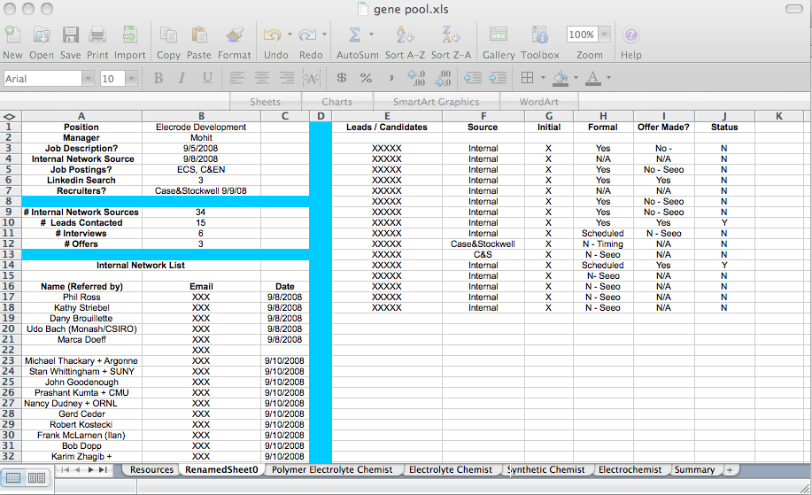
Facilitating/Tracking the Process

Slide 9
Facilitating/Tracking the Process
Make process as streamlined as possible
Various apps out there to manage process
Communications / recruitment hit list will be different for different positions
Your board will appreciate stats on efforts

Slide 10
Staying on Point

Slide 11
Staying on Point
Put your resources where your risks are!
Match hiring needs to major risk areas, not arbitrary roles
Review and adjust you hiring needs/goals on a regular basis

Slide 12
The Courting Ritual
Attract first, decide later. Evaluate the candidate, but always sell the company (both implicitly and explicitly).
You want everyone who walks through the door to want more than anything to work with you.
Communicate with the candidate – don’t assume you know what they are thinking or doing

Slide 13
Evaluating the Candidate
Never hire for experience over intrinsic ability, unless making that compromise is the only way to retire a key risk.
Know whether you are hiring for an independent brain or dependent hands – generally a binary choice.
Interview is like a first date – limited insight into long-term fit. Trusted network referrals are best indicator.
Trust your gut and keep your standards high – a team with a vacancy is better than same team with B player – hard to keep standards under pressure to hire.

Slide 14
Typical Process
Review application materials
Were they referred/recommended by trusted source
Do they have experience we said we needed
Worth a phone screen?
If yes, send template email to auto schedule 30 min phone screen
Phone screen
(8 mins) your pitch: background on company/opportunity and answer their key questions
(8 mins) their story: background, trajectory, and why they think this would be a fit
(8 mins) your critical questions: on their background, motivations, experience, expertise, etc.
(3 mins) discuss any key constraints: e.g. geography, visa, compensation.
(3 mins) wrap up: when possible, make real-time call on (A) not good fit, (B) invite for interview, (C) phone call w/ cofounder
Take notes, especially on pros/cons & anything you might want to probe further in future interactions
Interview
Schedule interview, arrange travel for them, send agenda in advance
1:1 meetings with all founders & key team members + some less formal interactions over lunch or dinner
Presentation by candidate when appropriate as an opportunity to test experience, thought process, etc.
Always be selling, try to portray natural culture/mode, ask for some work product if appropriate, tee up your team members in advance or in real time to probe specific characteristics of candidate, whenever possible make call in real time on (A) we’ll get back to you or (B), we think you’d be a great fit and would like to do some final diligence with your references and/or have you talk to our bad ass board member/advisor.
Reference checks (ideally 360º)
If they came through a trusted, experienced referral and all other aspects were positive, then reference checks are primarily to gain additional knowledge on strengths/weaknesses before you hire them.
If they did not come through a trusted referral, be sure to do both formal and backdoor checks.

Slide 15
Closing the Deal
Ideally you have a compensation range already pre-approved by board of directors (if needed)
As with anything, you want to get to a win-win.
Remember that value is set by the market and next-best alternative. That said, compensation is not necessarily the biggest driver for your candidate’s choice. That’s why you need to always be selling.
Psychology and expectation-setting are key to making sure your candidate feels as good as possible about the offer
Recruitment doesn’t stop at the offer: make sure they are excited on day one and beyond – small efforts make huge impact

Slide 16
Not done yet…
Recognize mistakes quickly, and immediately prepare to fix them…but give folks a chance.
Listen to your gut. If it feels wrong, it probably is.
Celebrate the team internally and externally – leverage it as an asset to your brand.

Slide 17
Working Session
Define the need
Key risk: what problem/risk do I need to solve?
Expertise needed: what expertise/experience is needed to address risk?
Network sources: who that I trust and respect might know this hire?
Talent pools: where might this hire have gained the expertise/experience?
Craft the description
Generic template
One sentence definition of the role
Primary responsibilities bullet points
Requirements bullet points
Build the tracker or set up app
Track who you’ve contacted to promote position
Track all candidates/applications
Notes on every key interaction/action, including reason for rejecting candidates at each stage
Craft the email
1-2 short sentences on why your company is exciting/great
1-2 short sentences on the job and specifically outlining key boundary conditions of the person you want to hire
1-2 short sentences or bullets on why this is a great opportunity
Key info on how/when to apply and attach/link job description

